Slide 1

Age Friendly Raymond Community Connections
General Assembly Meeting
June 10th, 2019

Slide 2

Agenda
Communication:
2nd Annual Garage Sale - August 3rd
Seeking volunteers; 1st meeting follows this meeting
Facebook updates
AgefriendlyRaymond.com updates
June Topic - Estate Planning and Elder Law
Guest Speaker: Lisa Friedlander
Next Community Connections Meeting:
July 8th - Raymond Casco Historical Society - Frank McDermott, President
NO MEETING IN AUGUST

Slide 3

Guest Speaker:
Topic: Estate Planning and Elder Law

Slide 4
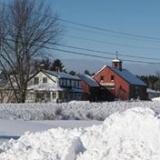
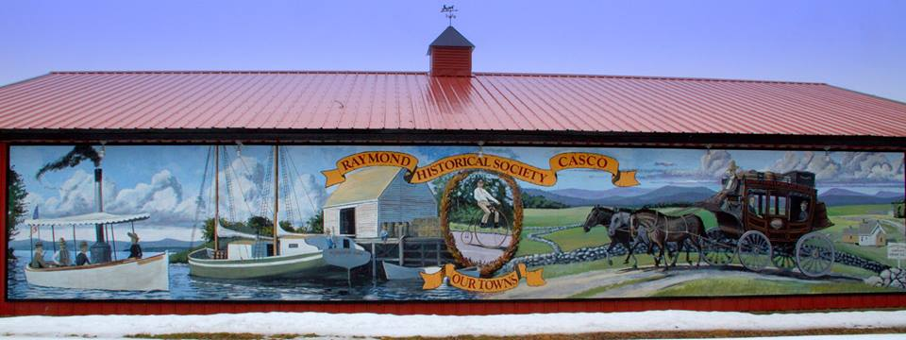
July 8th Raymond Casco Historical Society Guest Speaker: Frank McDermott, President

Slide 5
August – Summer Break!
There will be No meeting

Slide 6

2nd Annual
Age Friendly Raymond
Yard Sale
Saturday - August 3rd
Sheri Gagnon Memorial Ball Park - Raymond
Please join our "Yard Sale Planning Committee"
(1st meeting will follow the next Community Connections meeting on June 10th)
Help Needed:
Signage creation and placement
Rental Table sign up
Yard Sale "Donation" management
Set-up and manage AFR table
Communication planning (Windham Eagle, Lake Region Weekly, Raymond news letter......)
Contact Laurie at 655-2222 with questions

Slide 7

The End!

